Slide 1
INTELLIGENT CUSTOMER HELP-DESK WITH SMART DOCUMENT UNDERSTANDING- SB23356
BY:- ANKIT JAIN
PROJECT_ID: SBS_PRO_99

Slide 2
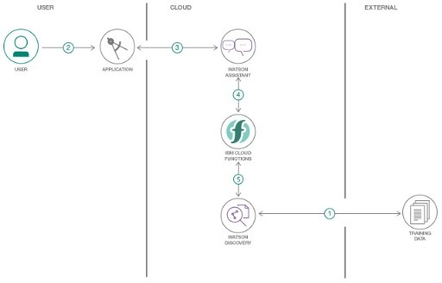
FLOWCHART OF CHATBOT

Slide 3
SMART CHATBOT
STEP
STEP
STEP
STEP
1
2
3
4
IBM CLOUD FUNCTIONS
WATSON ASSISTANT
CONFIGURING VIA NODE-RED
W. DISCOVERY
This service is integrated to enable smart document understanding..
These functions are added to integrate Discovery to Watson Assistant..
This service is the voice of assistant..
Used to test and deploy the final chatbot..

